Slide 1
Income effect, substitution effect and price effect
Dr. Jalandhar Pradhan

Slide 2
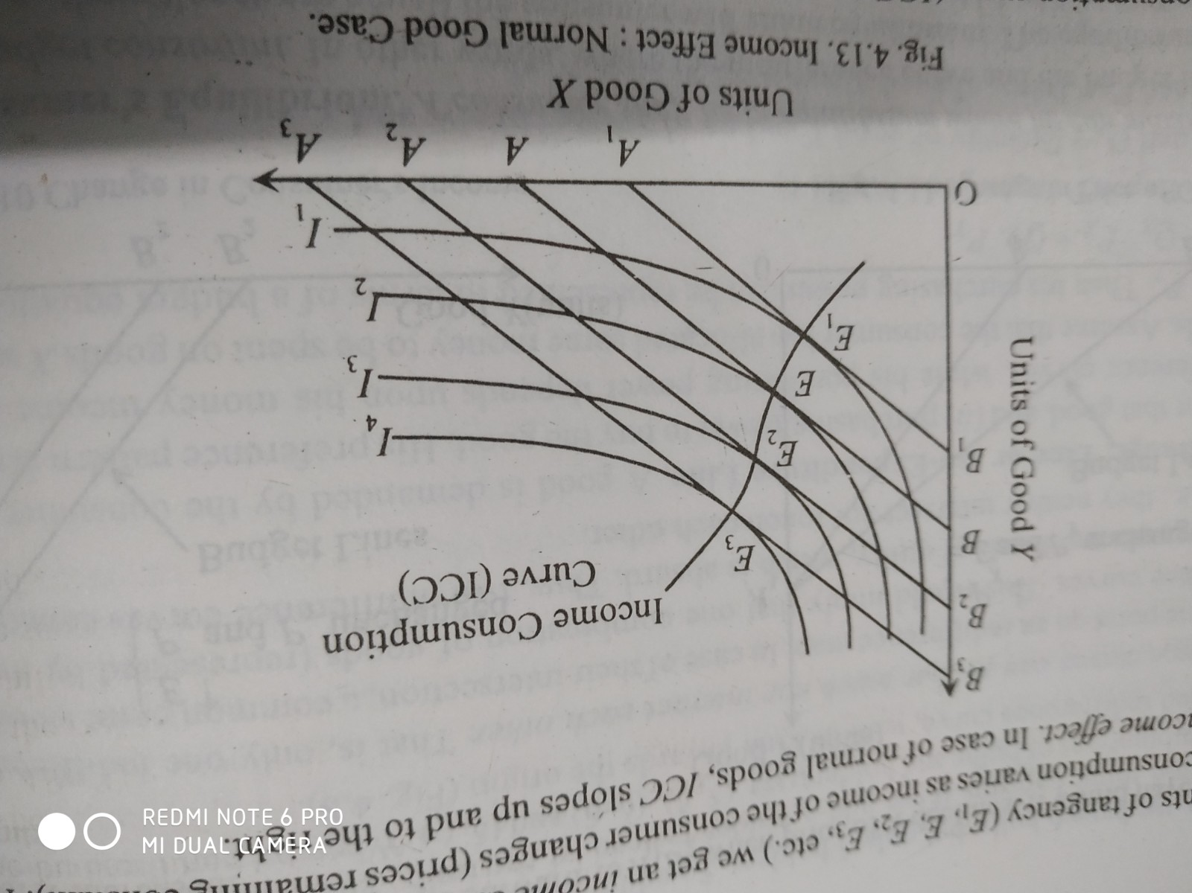
Income effect
ICC shows the way in which consumption varies as income of the consumer changes (prices remaining constant). The change is known as income effect.

Slide 3
Types of income effect
For Normal good its positive
Can be zero or negative
Zero: consumer buys in fixed quantities (drugs etc)
Negative : inferior good (e.g. cereals etc)

Slide 4
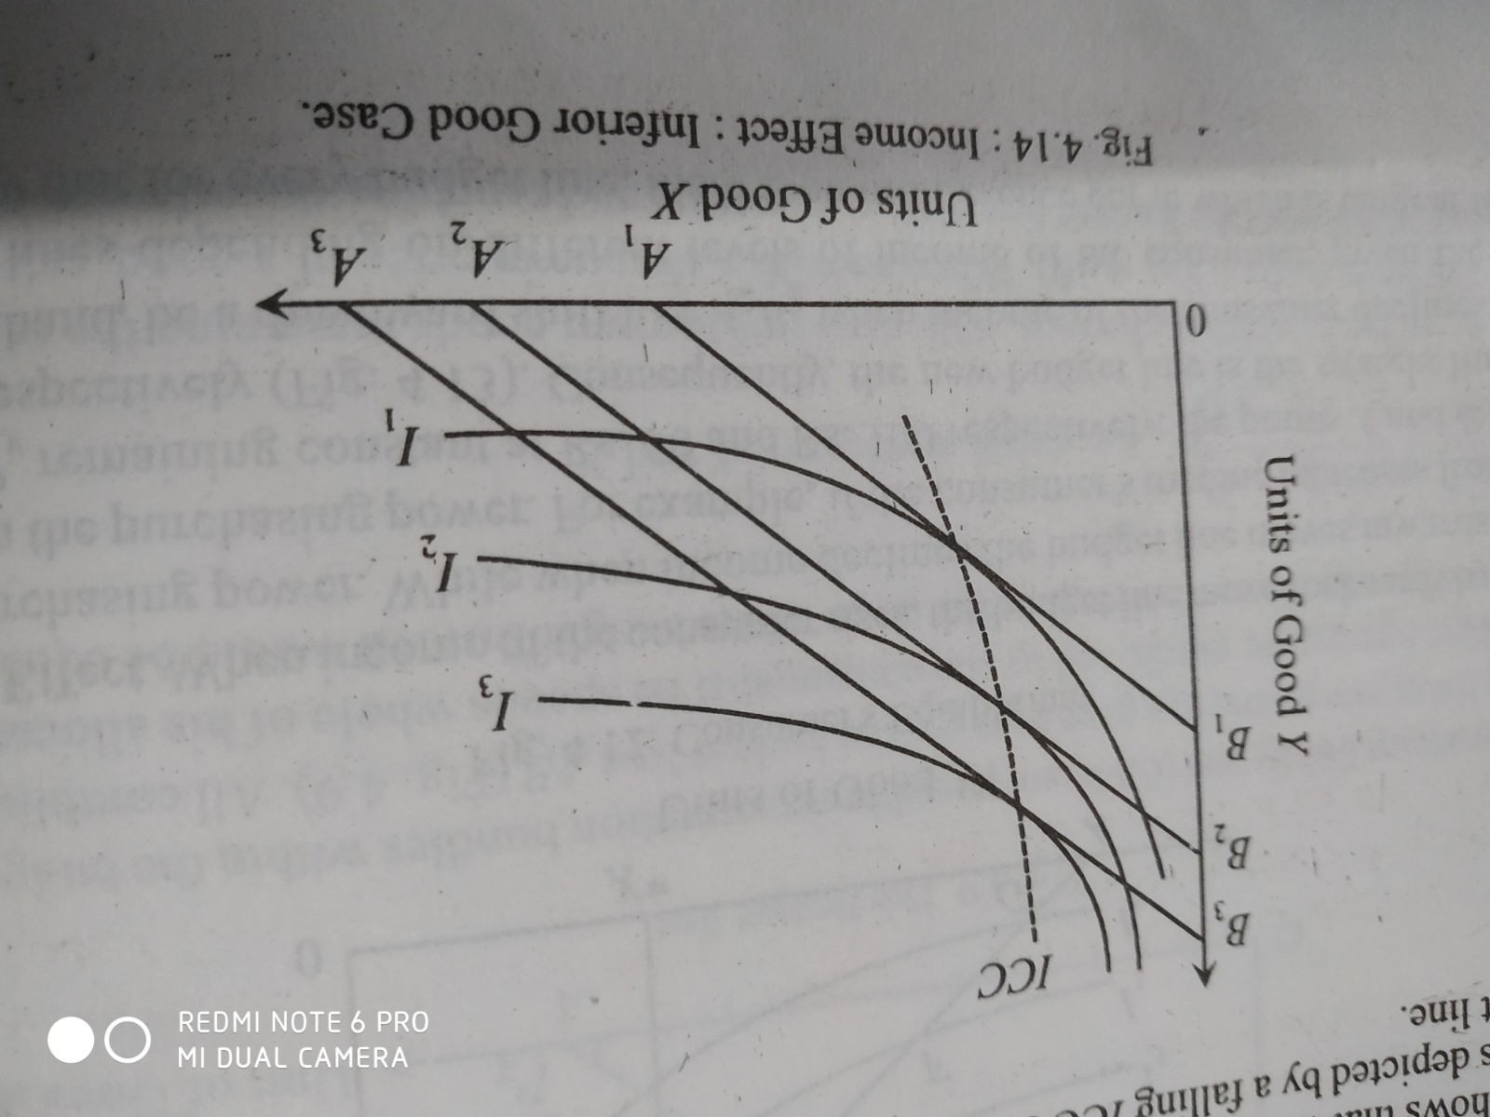
Income effect: inferior good case

Slide 5
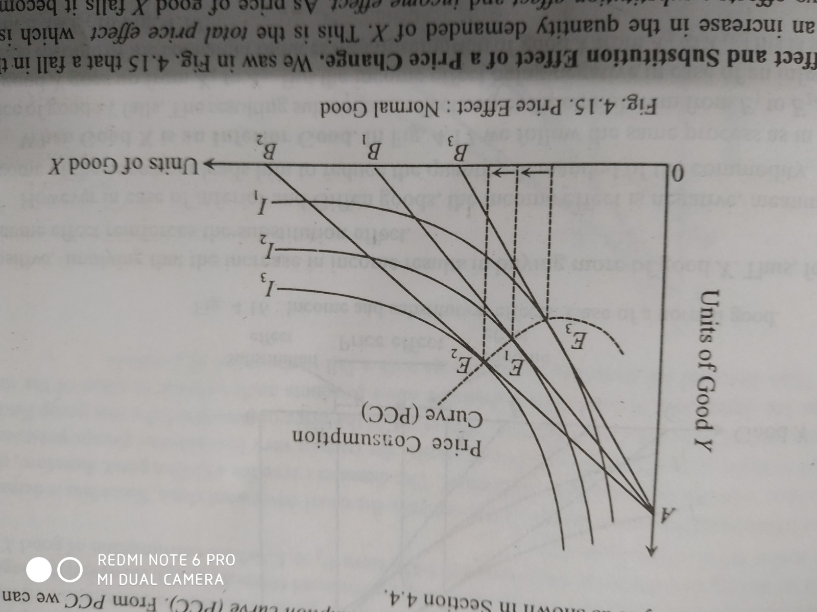
Price effect
PCC shows the price effect.

Slide 6
Income effect and substitution effect of price change
Price Effect=income effect+ substitution effect

Slide 7
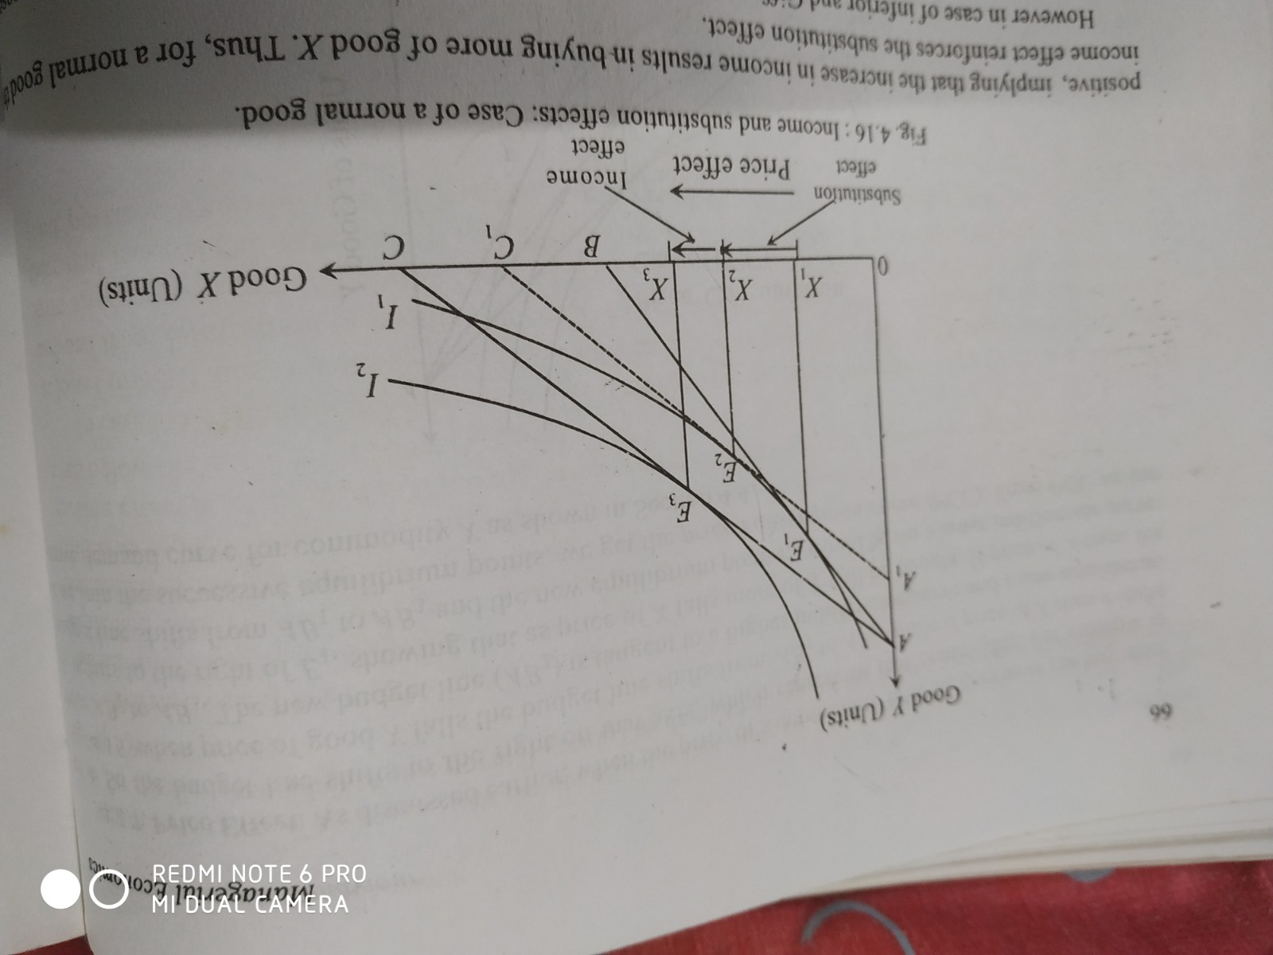
When good ‘x’ is a normal good

Slide 8
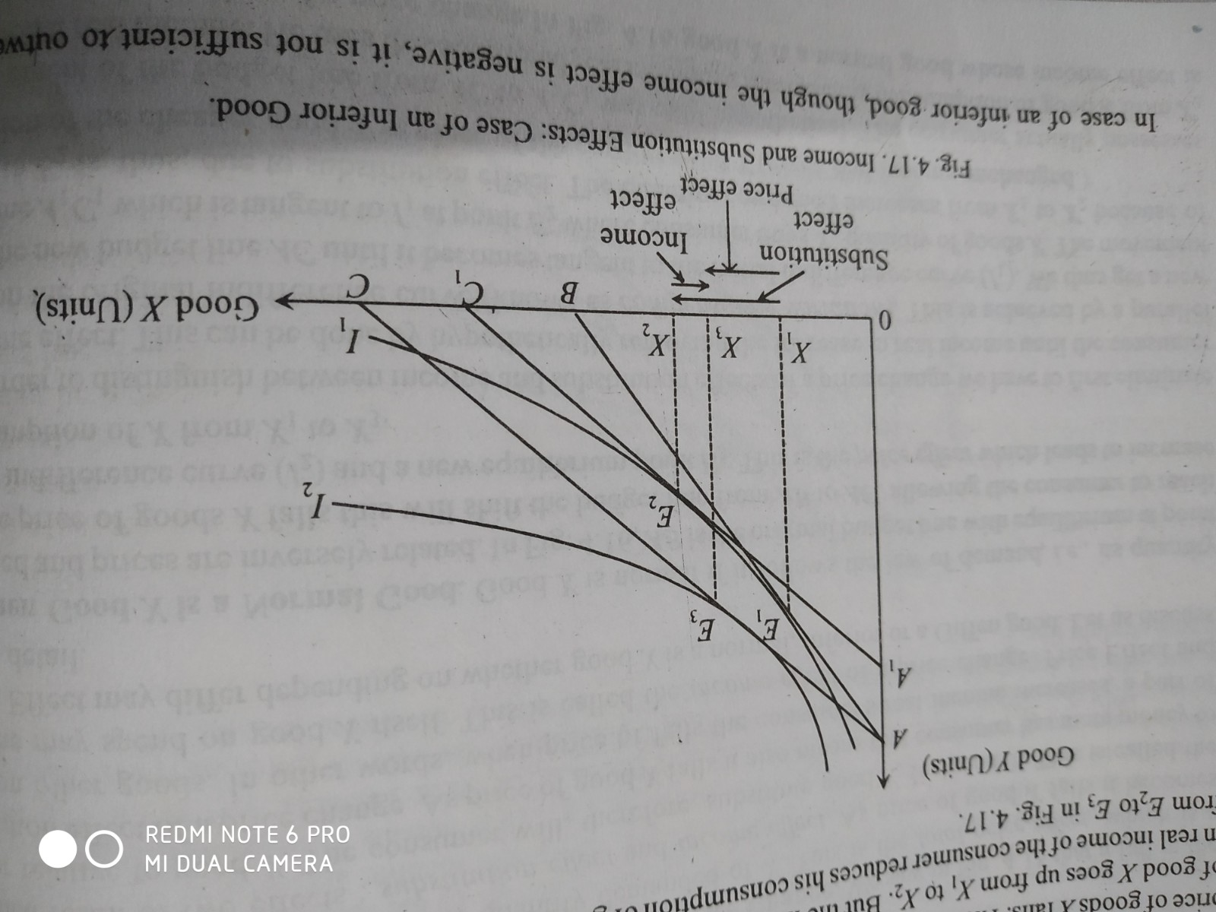
When good ‘x’ is a inferior good

Slide 9
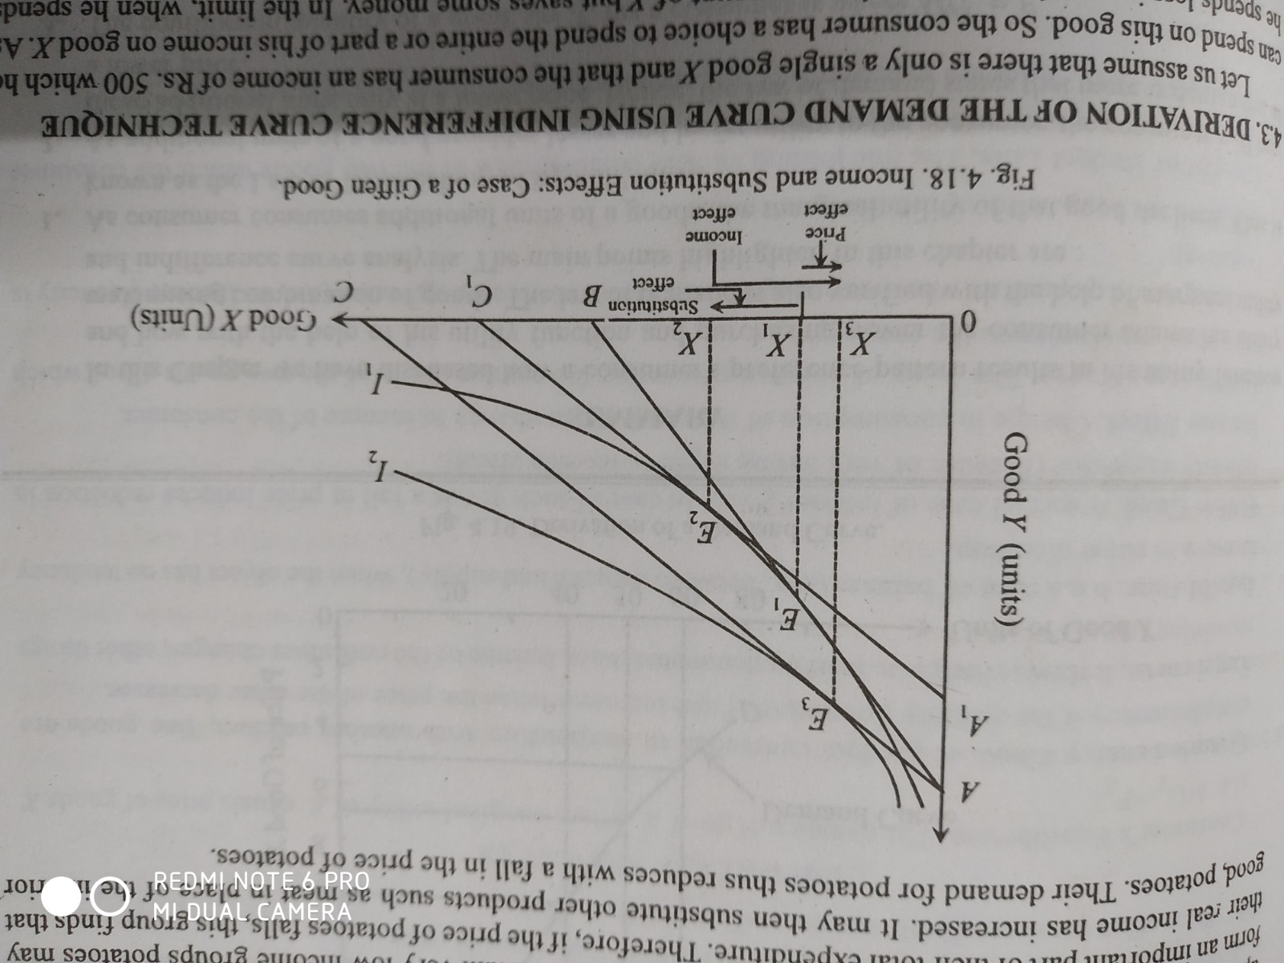
When Good ‘x’ is a Giffen good
A Giffen good is a special case of inferior good. A good in whose case substitution effect outweighed by the negative income effect.

